Slide 1


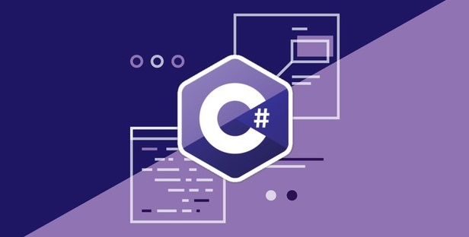
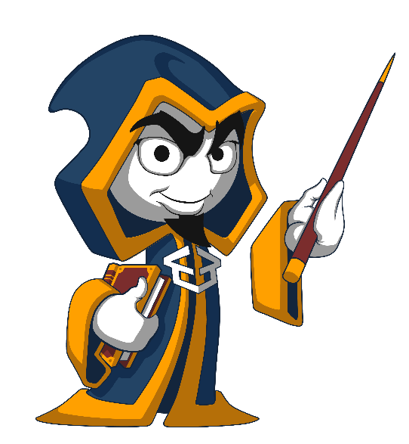
Programming Fundamentals
Course Introduction
Programming Fundamentals
SoftUni Team
Technical Trainers
Software University
http://softuni.bg

Slide 2
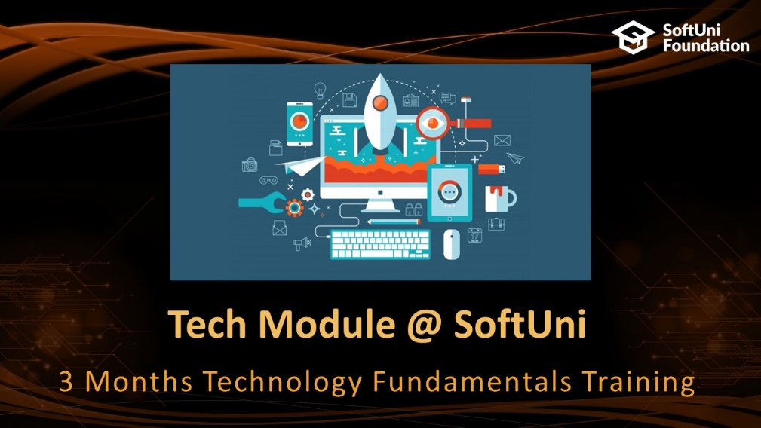




Table of Contents

Slide 3







SoftUni Diamond Partners

Slide 4
Questions
sli.do #fund-softuni

Slide 5

Tech Module @ SoftUni
3 Months Technology Fundamentals Training

Slide 6
Tech Module: Goals
"Technology Fundamentals" Module @ SoftUni
4 times weekly, lots of live coding and exercises
Part I – Programming Fundamentals
Arrays, lists, dictionaries, collections, lambda and LINQ, objects, files, strings, regular expressions, …
Part II – Software Technologies
Get acquainted with the most popular technologies out today
HTML, PHP Web, JavaScript Web, Java Web, C# Web

Slide 7
Tech Module at SoftUni – Timeline
18-Sept-2017
06-Nov-2017
Jan-2018
Programming Fundamentals
Lessons + exercises + exam
7 weeks * 4 times / week
6 credits
Start: 18-September-2017
Final exam: 05-November-2017
Software Technologies
Lessons + exercises + exam
6 weeks * 5 times / week
12 credits
Start: 06-November-2017
Final exam: 03-January-2017
Programming Fundamentals Re-Take Exams
First week of January 2018

Slide 8
Professions @ SoftUni
Programming Basics
Java
Fund.
Java
DB
Java
Web
JS Core
Tech Module
C#
Fund.
C#
DB
C#
Web
JS Core
Programming Fundamentals
JS Core
MEAN
Stack
Web
Basics
Software Technologies
PHP
Web
Web
Basics
JS Core
https://softuni.bg/curriculum
https://softuni.bg/trainings/courses

Slide 9

Programming Fundamentals
Course Objectives & Program

Slide 10


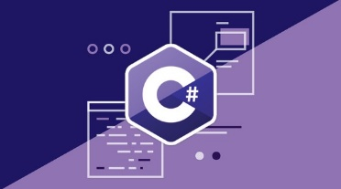
Programming Fundamentals – Course Program
Course Introduction – Course Program, Trainers, Exams, Resources
C# Intro: Basic Syntax, Using Visual Studio
C# Intro: Conditional Statements and Loops
Git & GitHub – Version Control Systems
Data Types – Numeral Types and Type Conversion
Methods and Debugging – Finding and Fixing Bugs in Programs
Arrays – Simple Array Processing
Lists – Processing Variable Length Sequences

Slide 11
Programming Fundamentals – Course Program (2)
Dictionaries, Lambda and LINQ – Collections and Queries
Objects and Simple Classes – Use / Define Objects and Classes
Files, Directories, Exceptions – Working With the File System and Handling Exceptions
Strings and Text Processing – Processing and Manipulating Text
Regular Expressions – Modern Text Processing
Exam Preparation – Practical Exam Problems (3 times)
Practical Exam – 4 Problems for 6 Hours

Slide 12

The Trainers Team

Slide 13
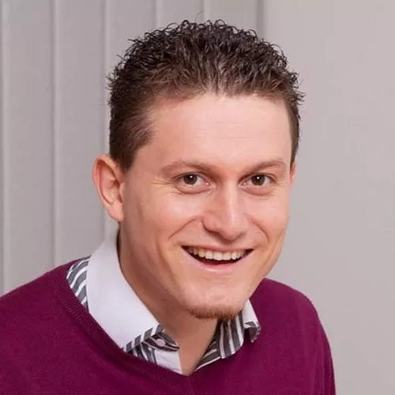
Trainers Team
Svetlin Nakov, PhD
Training & Inspiration Manager @ Software University (SoftUni)
20+ years as software developer
10+ years experience as trainer
Author of 8 programming books
Speaker at hundreds of events
Web site & blog: www.nakov.com

Slide 14
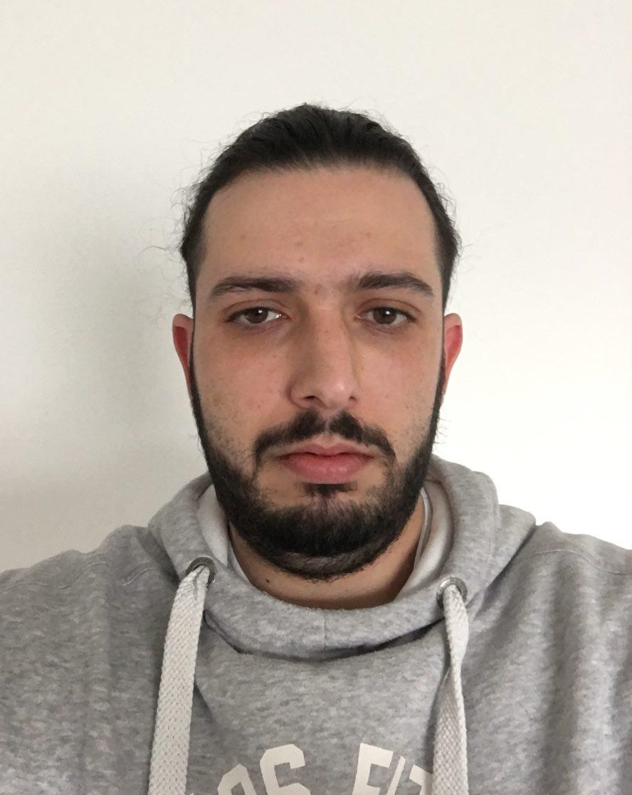
Trainers Team
Ventsislav Ivanov
Technical Trainer @ Software University
Certified QA
Knowedge at web testing
Experience as QA automation engineer

Slide 15

Programming Fundamentals: More Details
Duration, Languages, Technologies

Slide 16


Training Duration – Programming Fundamentals
Lessons: ~50 hours (onsite + videos)
Practical exercises (in class): ~60 hours
Exam preparation: 3*4 hours
Exam: 6 hours
Schedule: September – November 2017
Exam date: 05 November 2017

Slide 17



Why English?
Why the slides are in English?
English is the native language of the software engineers
Specific terminology should be in English
Translations are inaccurate and funny
Just learn English!
No excuses

Slide 18



Learn to Search in Internet & Find Solutions!
The course assignments require to search in Internet
This is an important part of the learning process
Some exercises intentionally have no hints
Learn to find solutions!
Software development includes everyday searching and learning
No excuses, just learn to study!
Developers learn new technologies, tools, languages every day!

Slide 19

Evaluation

Slide 20
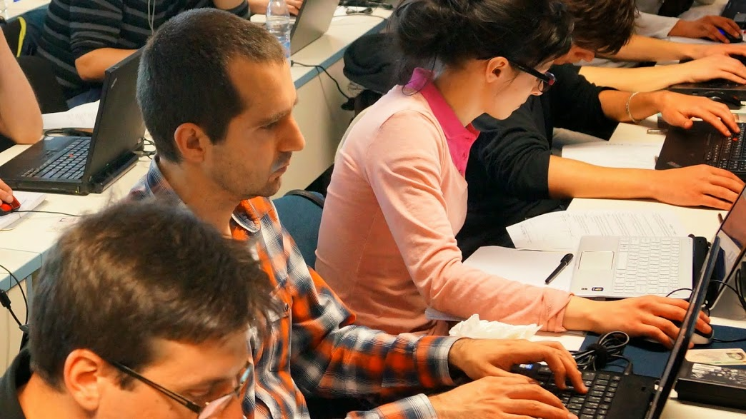

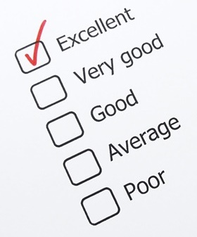
Programming Fundamentals
Evaluation Criteria

Slide 21


Scoring System for “Programming Fundamentals”
Exam – 90%
Homework (exercises) – 10%
Bonuses: up to 10%
Presence in class: 5% (onsite students only)
Forum activities
Others

Slide 22
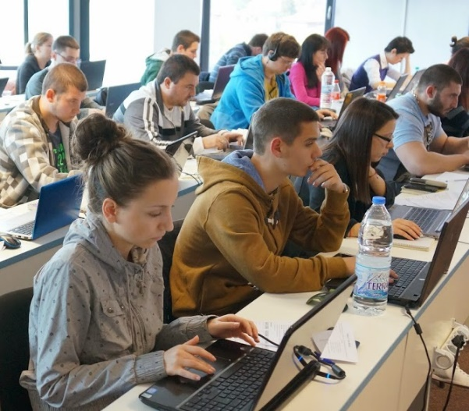

Programming Fundamentals Exam
Practical programming exam
4 practical problems for 6 hours
Simple arrays, lists, dictionaries, strings
Code in C# (Java, PHP, JS are also welcome)
Automated judge system
http://judge.softuni.bg
Solutions are evaluated for correctness only
Code quality is still not measured

Slide 23

Homework Assignments
Doing your homework is very important!
Programming can only be learned through a lot of practice!
You should write code every day!
Each lesson is followed by many exercises
Try to solve them in class
The rest are your homework
Homework assignments are due in 6 days after each lecture
Submission through our online judge system: judge.softuni.bg

Slide 24










Resources
What We Need Additionally?

Slide 25
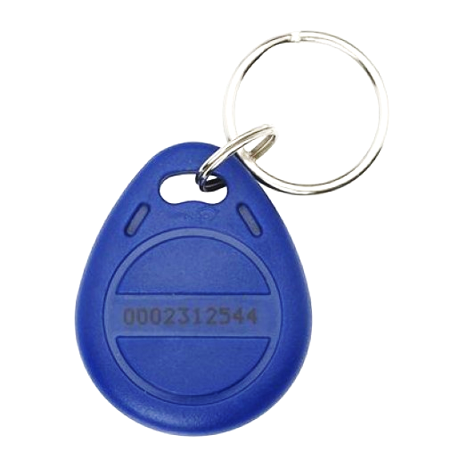
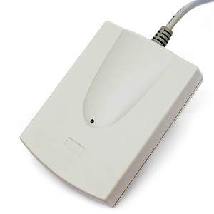
Your RFID Chip
Students can either
Take RFID chip from SoftUni
Or use their own chip / card
Register your chip number in your SoftUni profile: https://softuni.bg/users/profile/show
Check-in at the reception every time when you come
See your last visits in your profile: https://softuni.bg/users/profile/show

Slide 26



PF Course Web Site, Forum and FB Group
Official web site:
Official discussion forum:
Official Facebook groups:
https://softuni.bg/courses/programming-fundamentals
https://softuni.bg/forum/categories/44/programming-fundamentals
https://www.facebook.com/groups/tech.module.sept.2017

Slide 27

The Prog. Fundamentals Slides and Videos
All lecture slides, videos, homework assignments, projects and other resources are open content, available for free
Visit the course web site to access the course resources

Slide 28


The Free C# Fundamentals Textbook
Partial textbook for the course:
"Fundamentals of Computer Programming with C#", by Svetlin Nakov & Co., 2013, ISBN 9789544007737
English and Bulgarian versions (as PDF, ePub, …)
Freely downloadable from: www.introprogramming.info
The C# Programming courses @ SoftUni.bg partially follows the book
Programming Fundamentals → chapters 2, 3, 7, 9, 11, 13, 14, 16, 18, 22

Slide 29

Software University Learning System (SULS)
Software University Learning System (SULS)
www.softuni.bg
Important resource for students
Homework submissions
Homework check-up
Exams and results
Reports about your progress
…

Slide 30


Required Software
Software needed for this course:
Microsoft Windows (Win 10 / 8.1 / Win8 / Win7) or Mac or Linux
Visual Studio Community 2017 (a free version of VS 2017)
Older versions are acceptable, but not recommended
Alternative: MonoDevelop (for Linux / old Windows)

Slide 31


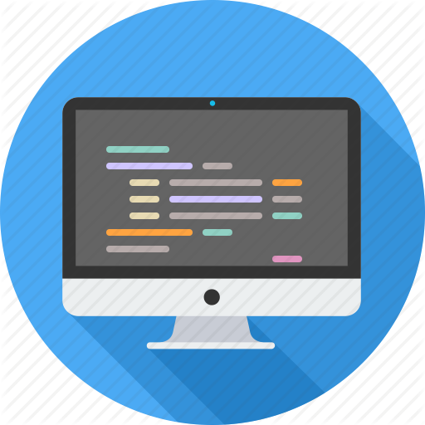

Summary
Training program
Data types, methods, debugging, arrays and lists, dictionaries, objects, strings and much more
Practical exam
4 problems for 6 hours
Learning resources
Slides, videos, software, books, forum

Slide 32
Programming Fundamentals – Course Overview
https://softuni.bg/courses/programming-fundamentals

Slide 33
License
This course (slides, examples, demos, videos, homework, etc.) is licensed under the "Creative Commons Attribution-NonCommercial-ShareAlike 4.0 International" license

Slide 34





Trainings @ Software University (SoftUni)
Software University – High-Quality Education, Profession and Job for Software Developers
softuni.bg
Software University Foundation
http://softuni.foundation/
Software University @ Facebook
facebook.com/SoftwareUniversity
Software University Forums
forum.softuni.bg

